Slide 1
Optimizing Drone Trajectories in a Grid World using Reinforcement Learning

Slide 2
Concepts: Pathfinding & Reinforcement Learning
Pathfinding: “Finding an optimal route in a grid-based environment with obstacles or specific cells of interest.”
Reinforcement Learning (RL): “An agent learns with an environment and receiving rewards or penalties.”
RL is suitable as an alternative to computer-demanding algorithms.

Slide 3
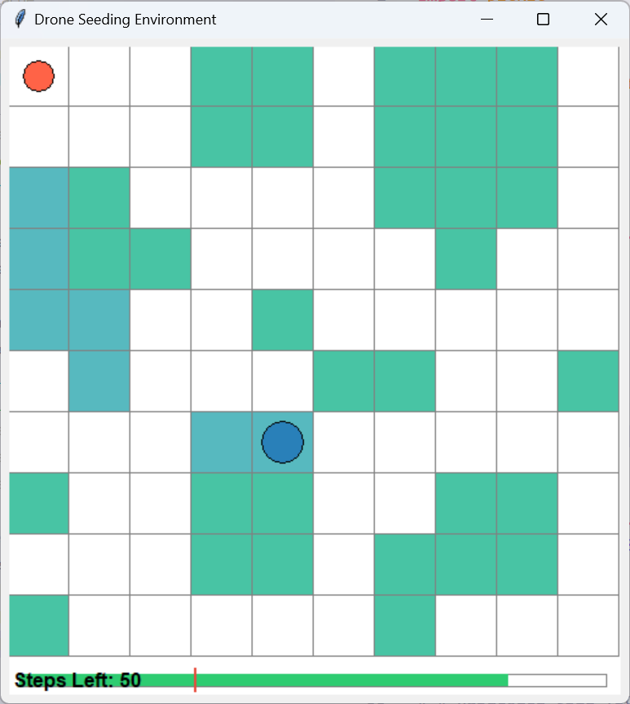
Drone Seeding Task
Grid of size 10×10 (or any NxN)
Some cells are labeled “seedable” (the drone must visit them)
Start position: (0,0) → must ideally return to the home point
Key constraints: limited steps (battery life)

Slide 4
Q-learning Algorithm
State definition: (r,c,steps_remaining)
Action space: {Up, Right, Down, Left}
Q-table dimensions: (grid_size,grid_size,steps_remaining,4)
Epsilon-greedy exploration with decay
Large number of training episodes

Slide 5
Reward Function
NAME | DESCRIPTION | VALUE
R_STEP | Step cost: negative reward to encourage efficiency | -0.02
R_NO_CELL | Walk to a non-seedable cell: negative to encourage visiting clusters | -0.03
R_REVISIT | Walk to an already visited seedable cell: negative to encourage exploration | -0.02
R_NEW_CELL | Walk to a non visited seedable cell: 0 reward (better than revisit or no_cell) | 0
R_BATTERY_DEPLETED | Negative when runs out of steps and the agent is not in starting position | -0.3
To encourage exploration, I based all the rewards on negative values. The closer to 0 the reward is, the better.

Slide 6
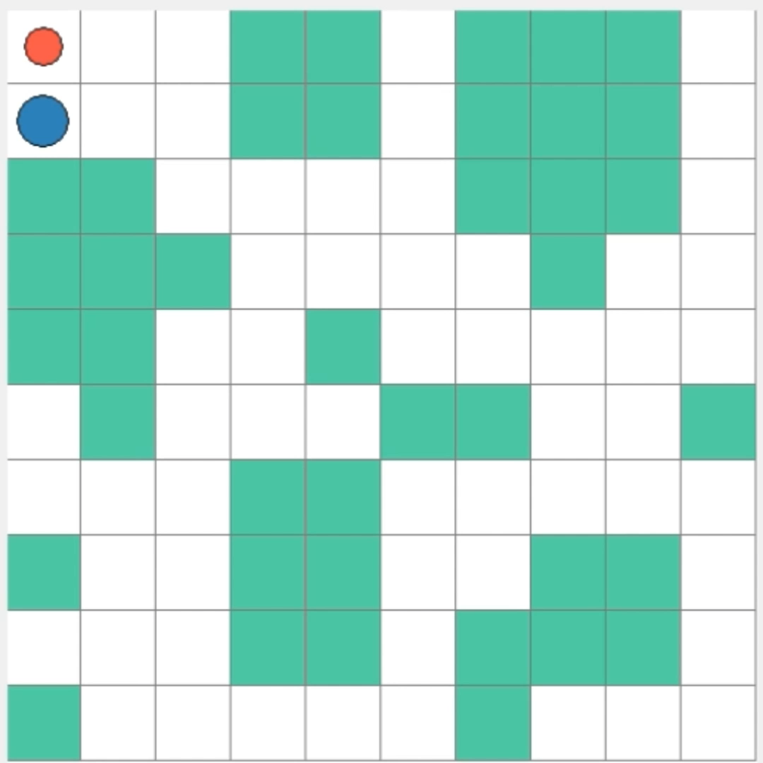
Visual Demonstration
Practice makes perfect
Agent Behavior:
The drone navigates the grid efficiently, covering all seedable cells.
Minimizes unnecessary revisits and optimizes movement.
Returns to the home position before battery depletion.
Training Outcome:
The learned policy successfully balances exploration and energy constraints.

Slide 7
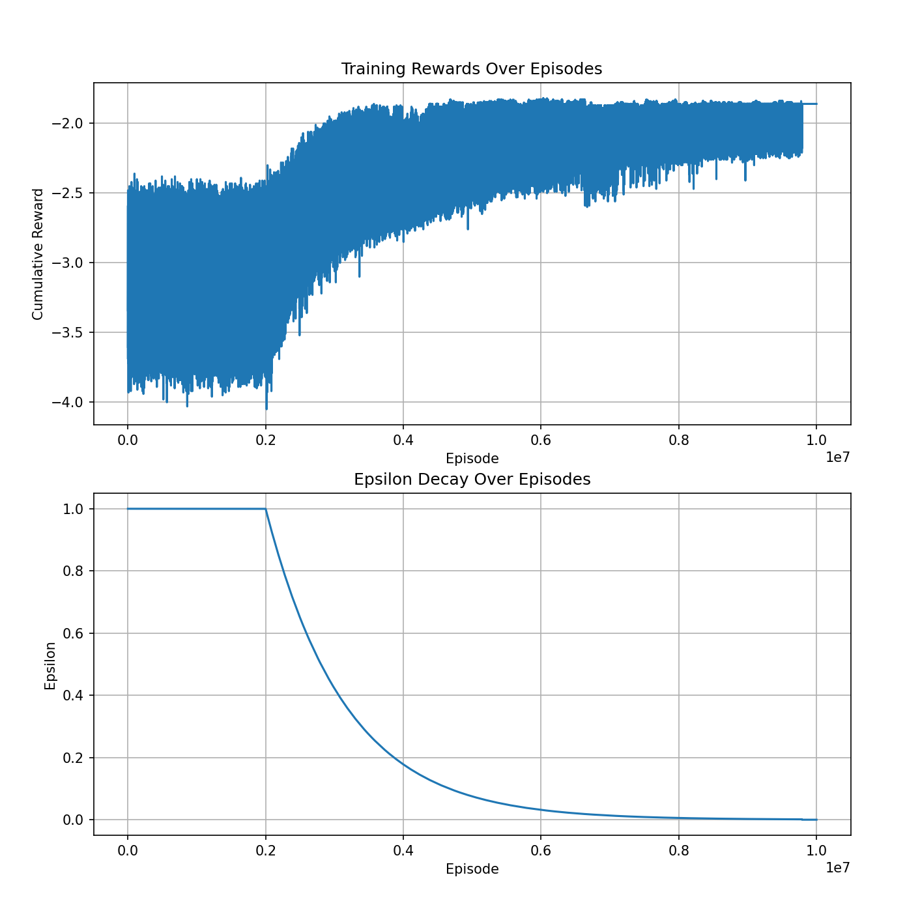
Cumulative reward
Epsilon greedy policy:
Warm-up episodes
Exponential decay

Slide 8
Conclusion & Next Steps
Achievements:
Developed an RL-based solution for optimizing a drone’s seeding path in a grid world.
Successfully trained policies that achieve full seeding coverage and return home.
Potential Improvements:
Explore Double Q-Learning or n-step Temporal Difference (TD) methods for better policy stability.
Extend the problem to larger grids or introduce dynamic obstacles to increase complexity.

Slide 9
THANK YOU

